Slide 1
United States v. Mladen Mitrovic 1:12-CR-311-AT
William G. Traynor, AUSA, Northern District of Georgia
will.traynor@ usdoj.gov
404-581-6000
November 15, 2017
The statements expressed here are those of the speaker
and not the United States Department of Justice

Slide 2
Yugoslavia, 1948-1990

Slide 3
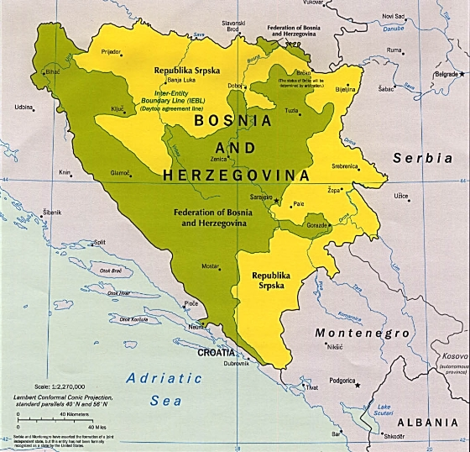
Bosnia-and-Herzegovina Today

Slide 4
Mitrovic trial -- List of place names, personal names and terms:
Place names (sounds like:)
Banja Luka (Bahn-ya Loo-ka)
Gradacac (Gra-dah-chats)
Kozarac (Ko-zar-ats)
Personal names (last name first)
BLAZEVIC, Azra (Bla-zhe-vich)
CEHIC, Edin (Che-khich)
HODZIC, Mirsad (Hoed-zhich)
JAKUPOVIC, Nedzad (Yah-koo-po-vich)
MERDZANIC, Idriz (Merd-zha-nich)
KURUZOVIC, Slobodan (Koo-roo-zo-vich)

